Slide 1










DATA
MANAGER
PRESENTATION
National Multidimensional Poverty Index
Version 1.0
USER PRESENTATION

Slide 2

VICT – DATA MANAGER
Data Summary
Data
Data Entry
Data Approve
Driver Data Entry
Indicator metadata
Import Data
Import Log
Download Data
Content
Category-Subcategory
Documents
Admin
Area
Time Period
Data Source
Indicator
Import Mapping
Classification
Classification type
Classification
User
Language
Notes:
The primary data management contains three steps – Ingestion, Cleaning and Calculate. Let us understand about each step.

Slide 3
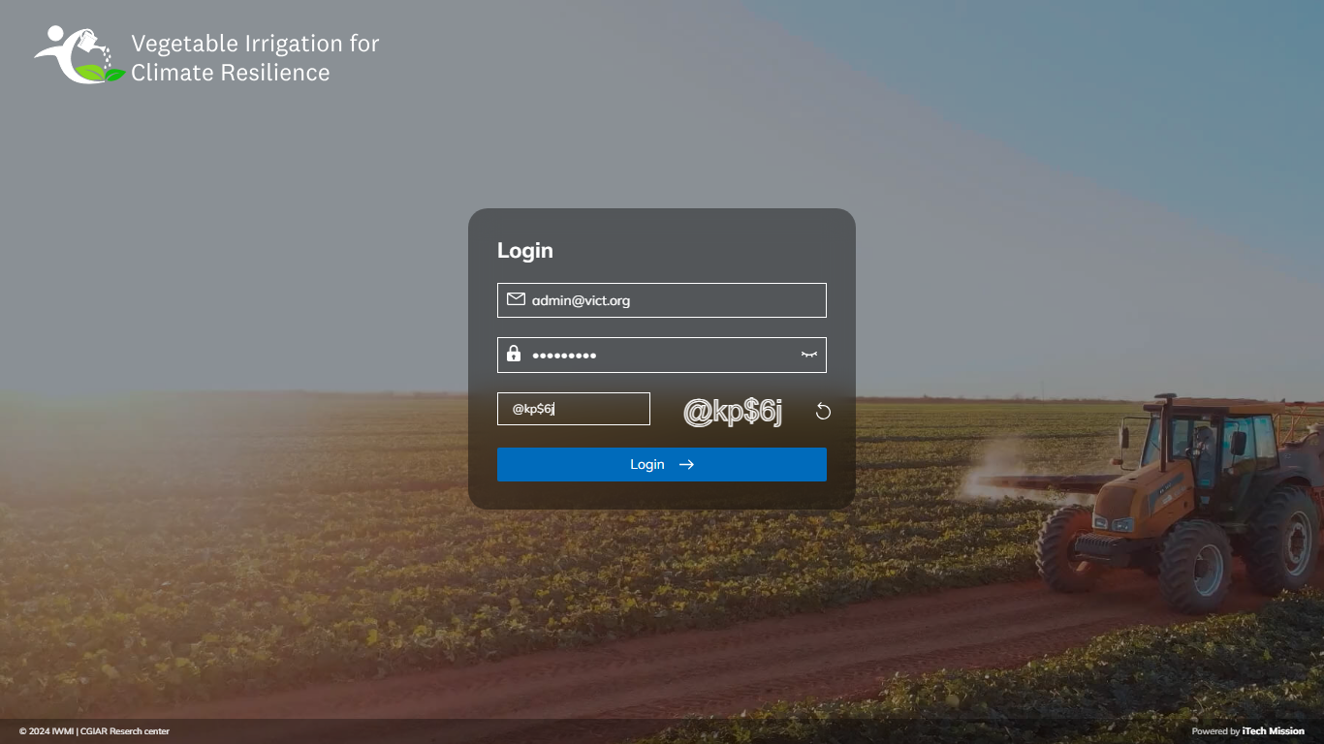
LOGIN PAGE
Enter email address, password and CAPTCHA to login.

Slide 4

1
Data Summary

Slide 5
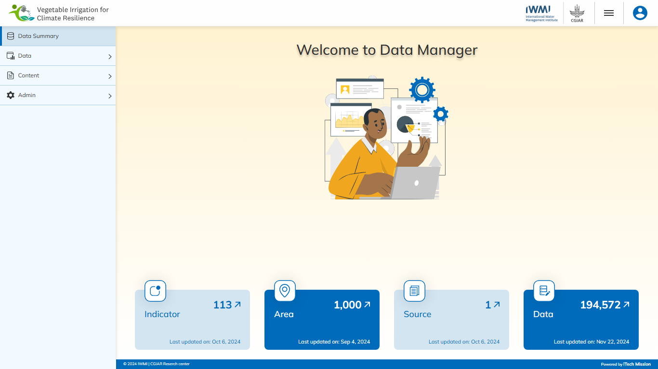
DATA SUMMARY
View count of Total Indicators, Area, Source and Data values.

Slide 6
2
Data –
Data entry

Slide 7
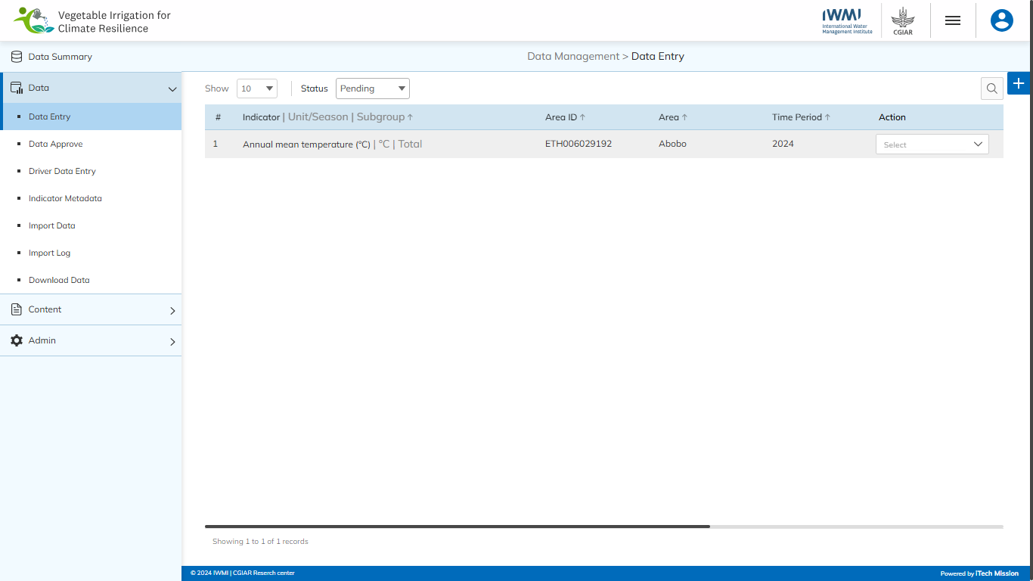
DATA ENTRY
Navigate to the “Data Entry” sub-module available under the “Data” module.

Slide 8
DATA ENTRY
Click on plus button to add new data.

Slide 9
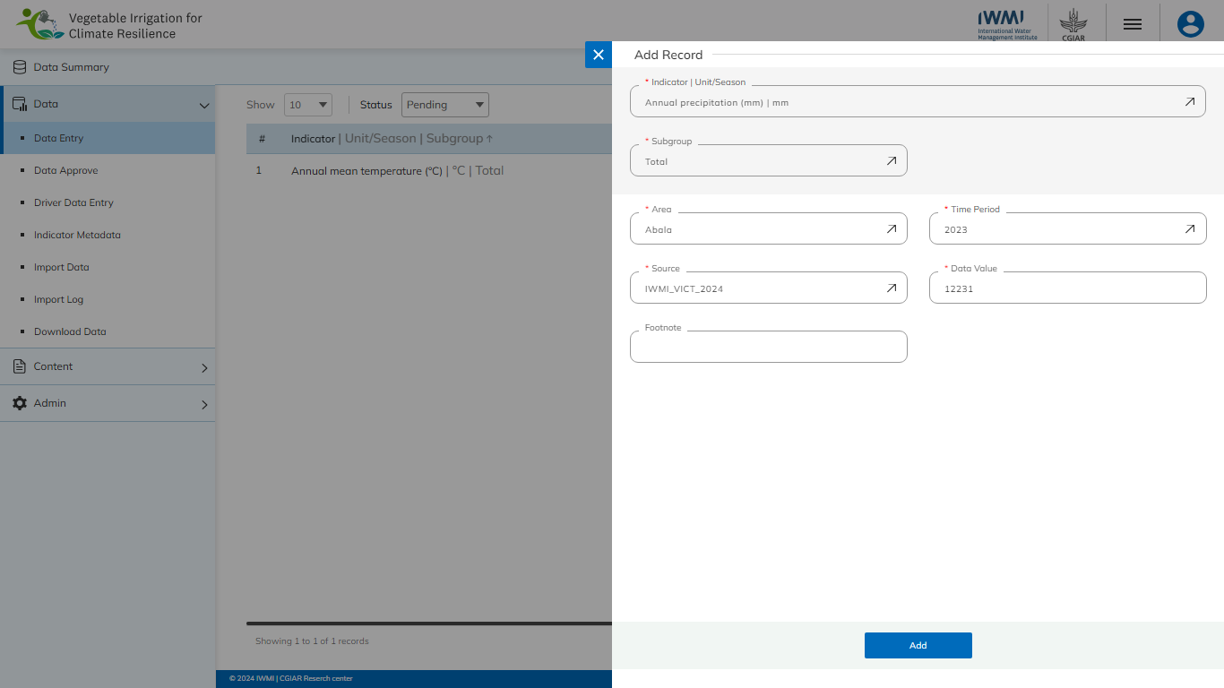
DATA ENTRY
Enter the mandatory details and click on Add button to confirm.

Slide 10
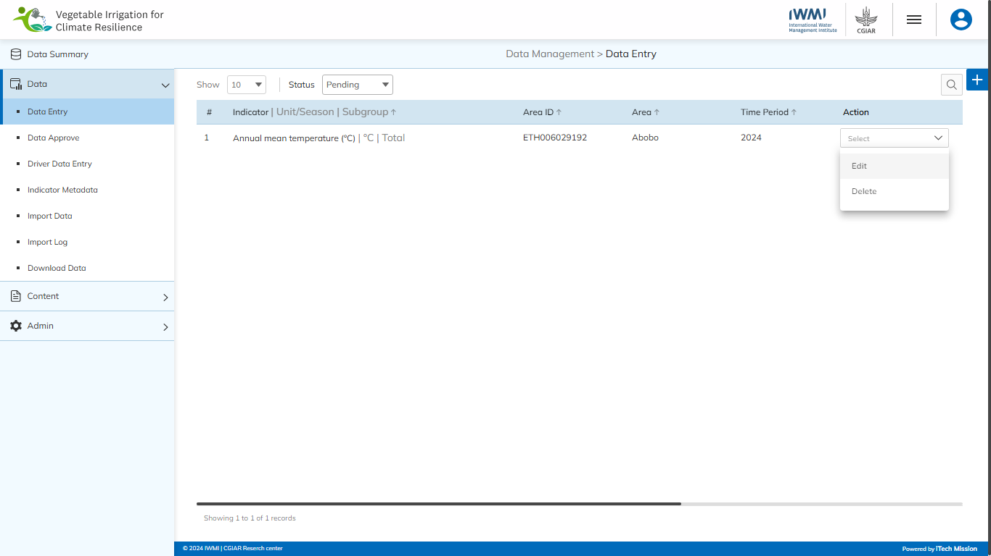
DATA ENTRY
Edit and delete the Pending Data.

Slide 11
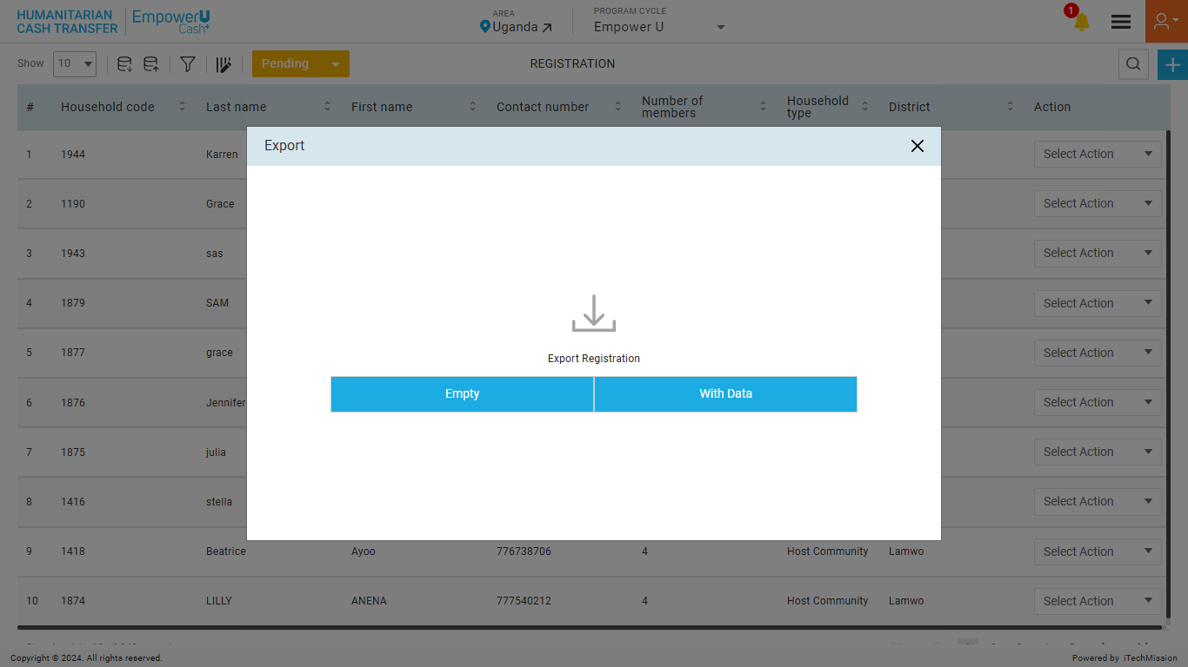
DATA ENTRY
Edit and delete the Pending Data.

Slide 12
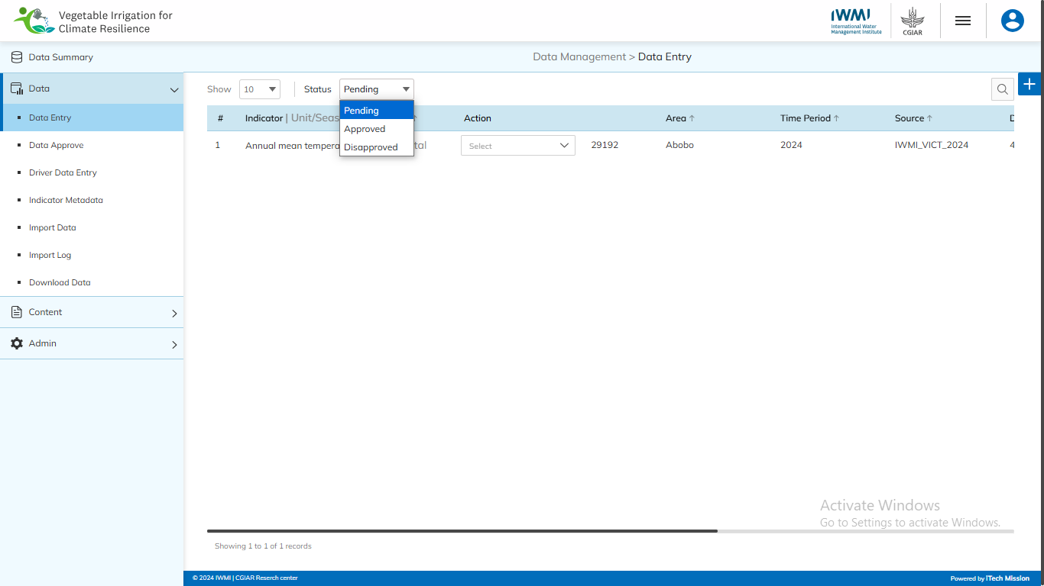
DATA ENTRY
Select from the “Status” dropdown to view the Approved or Disapproved Data.

Slide 13
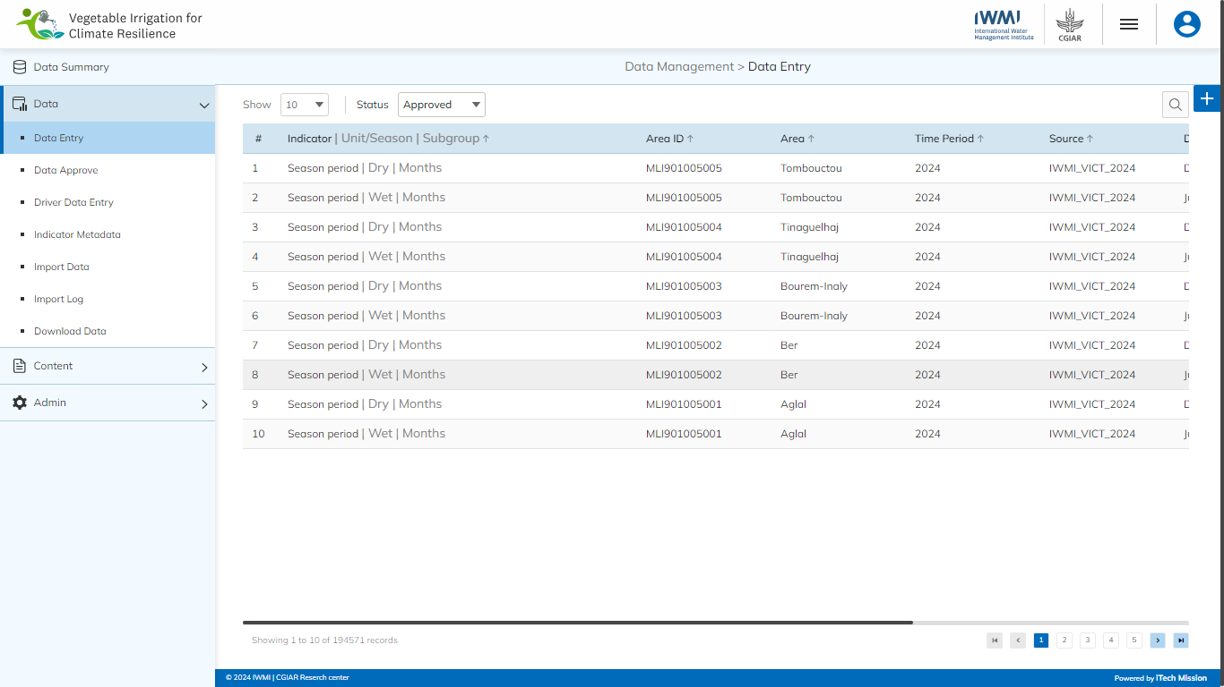
DATA ENTRY
View the list of Approved Data.

Slide 14

DATA ENTRY
View the list of Disapproved Data.

Slide 15

DATA ENTRY
Edit Disapprove Data and move it to Pending State or delete the data.

Slide 16
2
Data –
Data Approve

Slide 17
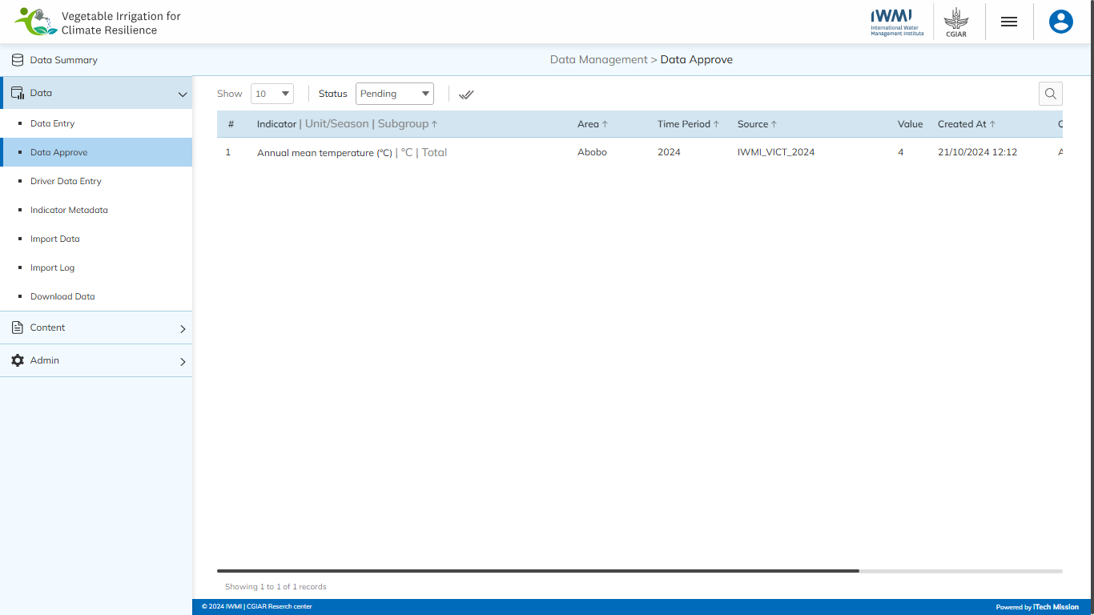
DATA APPROVE
Navigate to the “Data Approve” sub-module available under the “Data” module.

Slide 18
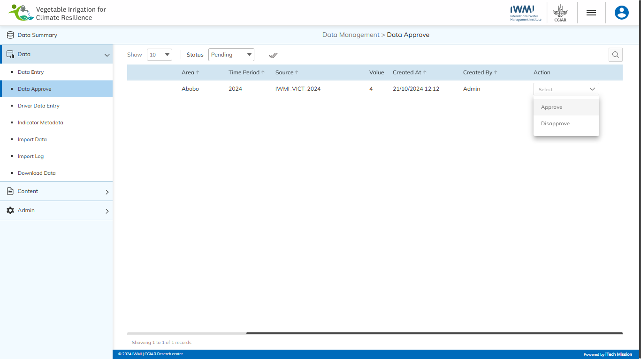
DATA APPROVE
Approve or Disapprove selected data in the Pending state.

Slide 19
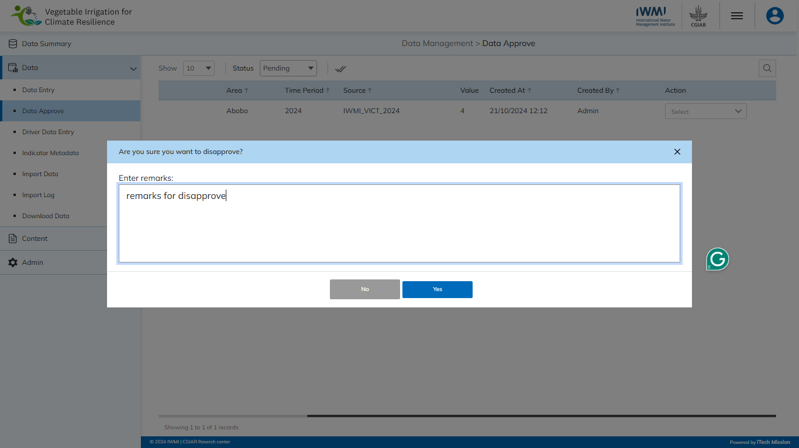
DATA APPROVE
Enter the reason of disapproval and click on the Yes button to confirm.

Slide 20
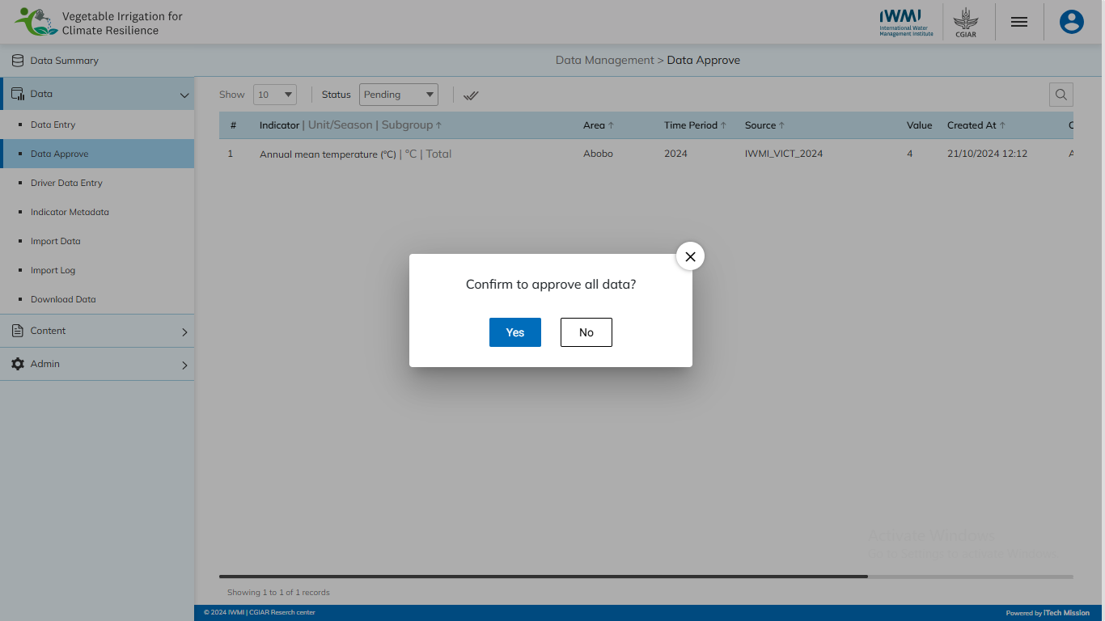
DATA APPROVE
Click on the Double Tick icon to approve all the pending data.

Slide 21
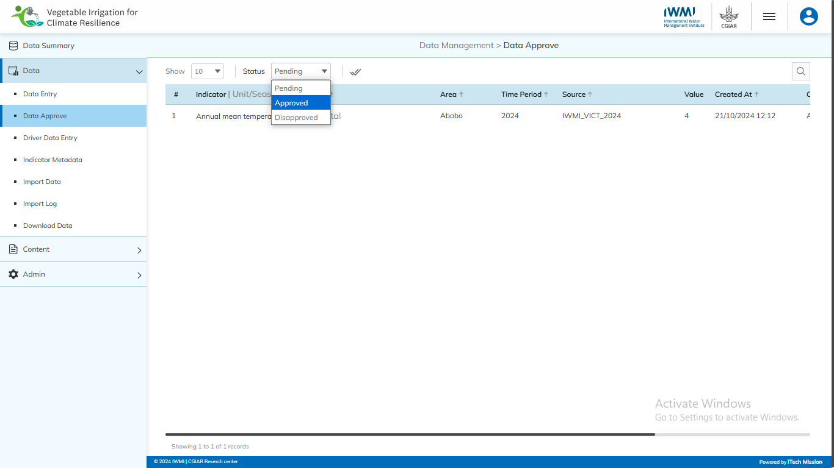
DATA APPROVE
Select from the “Status” dropdown to view the Approved or Disapproved Data.

Slide 22
2
Data –
Driver Data Entry

Slide 23
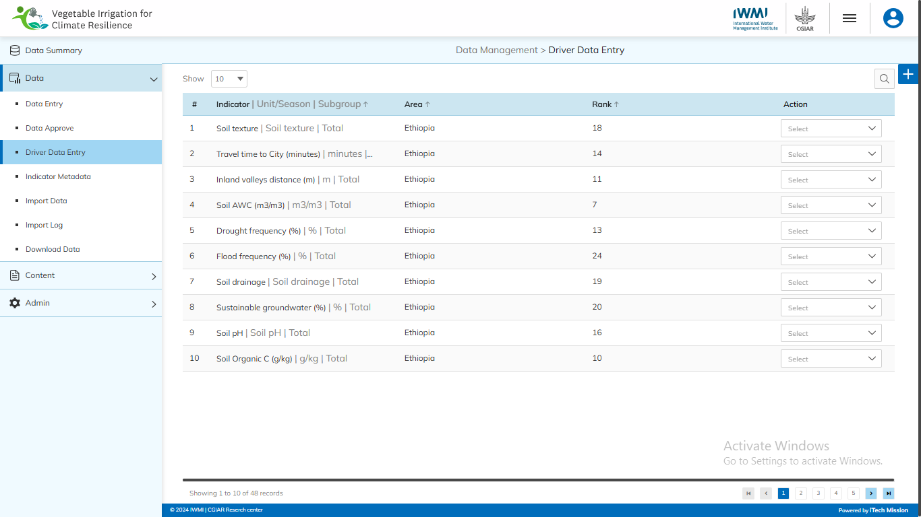
DRIVER DATA ENTRY
Navigate to the “Driver Data Entry” sub-module available under the “Data” module.

Slide 24
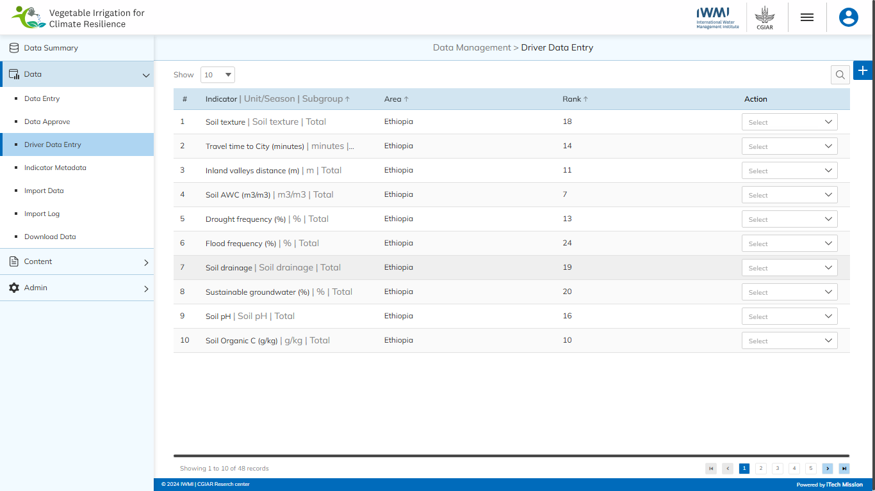
DRIVER DATA ENTRY
Click on plus button to add new driver data.

Slide 25
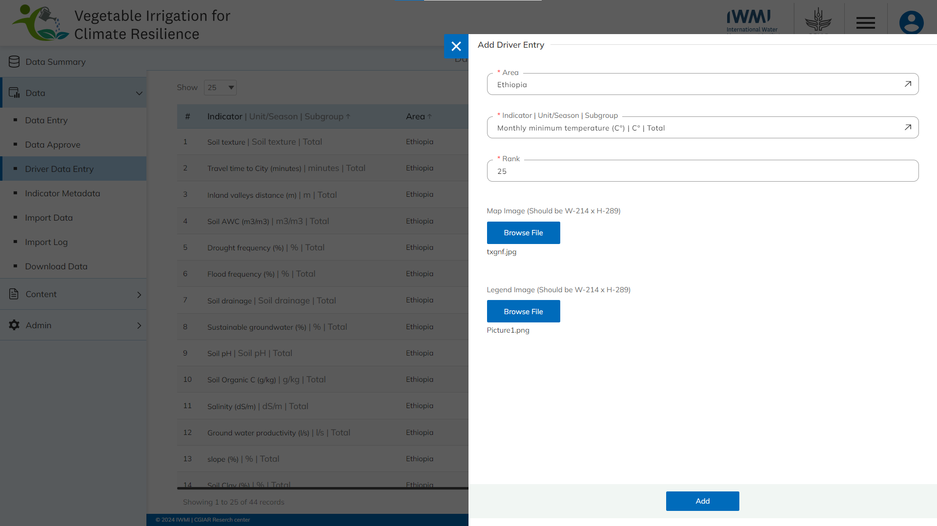
DRIVER DATA ENTRY
Enter the mandatory details and click on Add button to confirm.

Slide 26
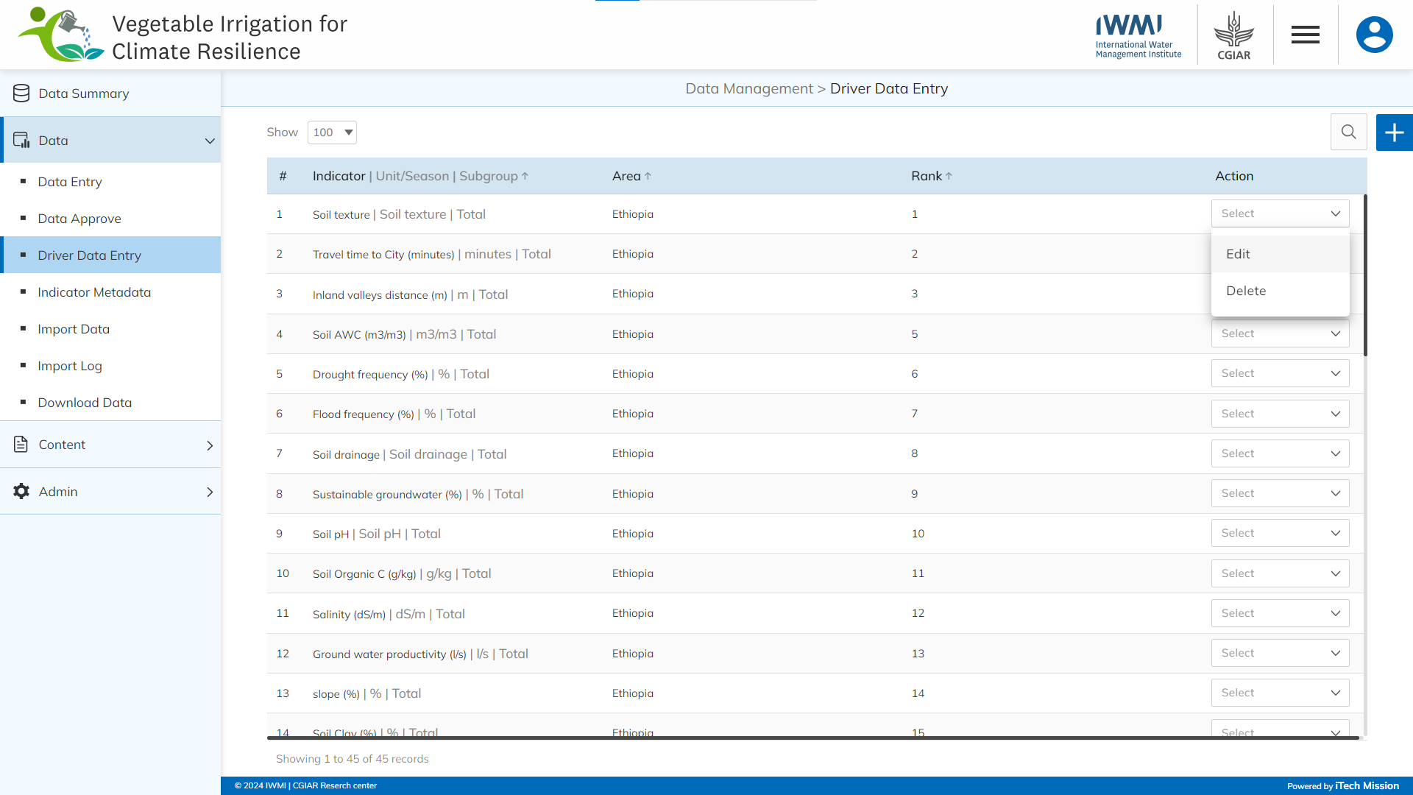
DRIVER DATA ENTRY
Edit and delete the selected Data.

Slide 27
2
Data –
Indicator Metadata

Slide 28
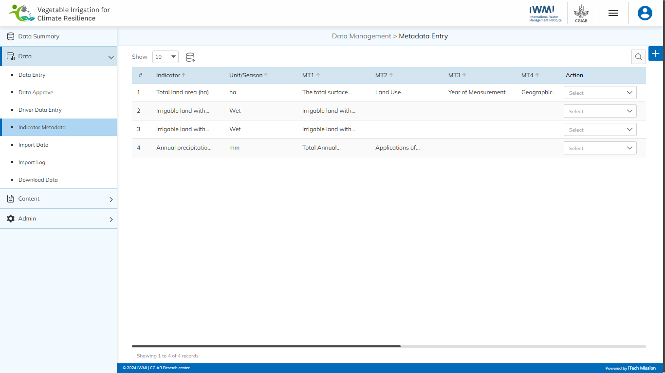
INDICATOR METADATA
Navigate to the “Indicator Metadata” sub-module available under the “Data” module.

Slide 29
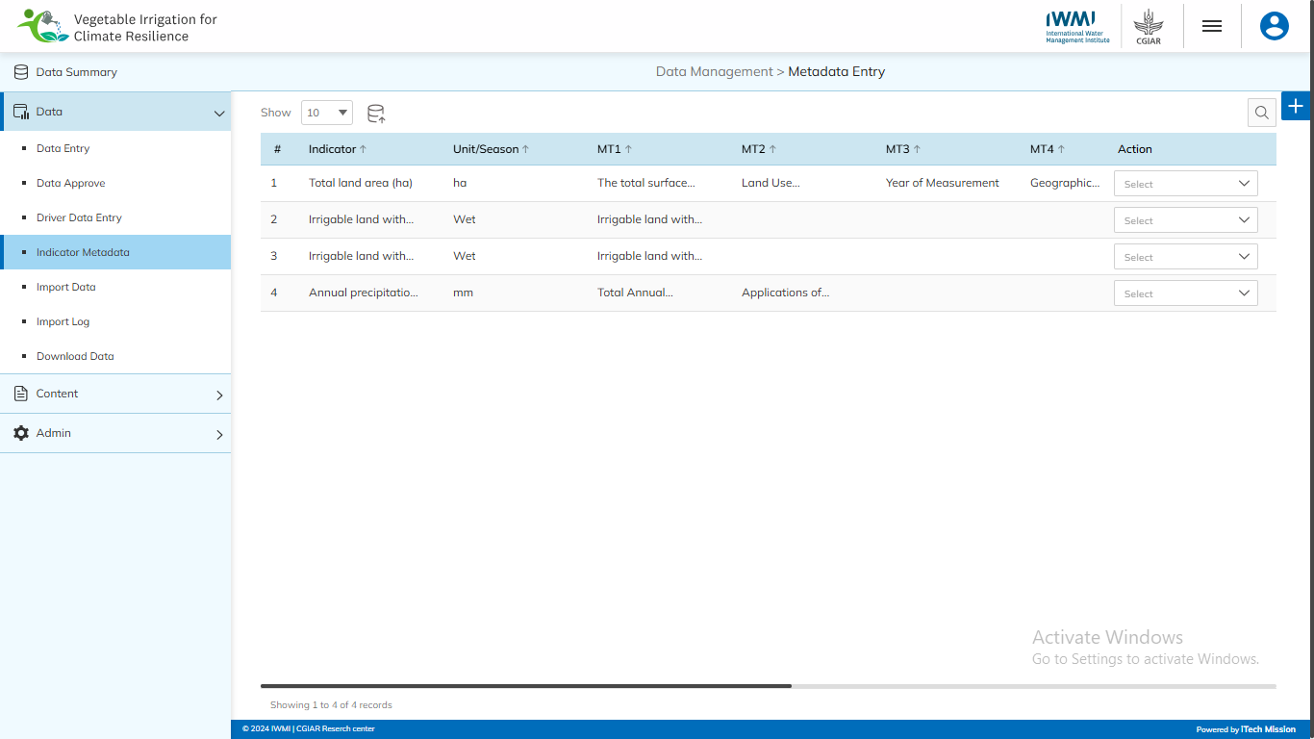
INDICATOR METADATA
Click on plus button to add new metadata.

Slide 30
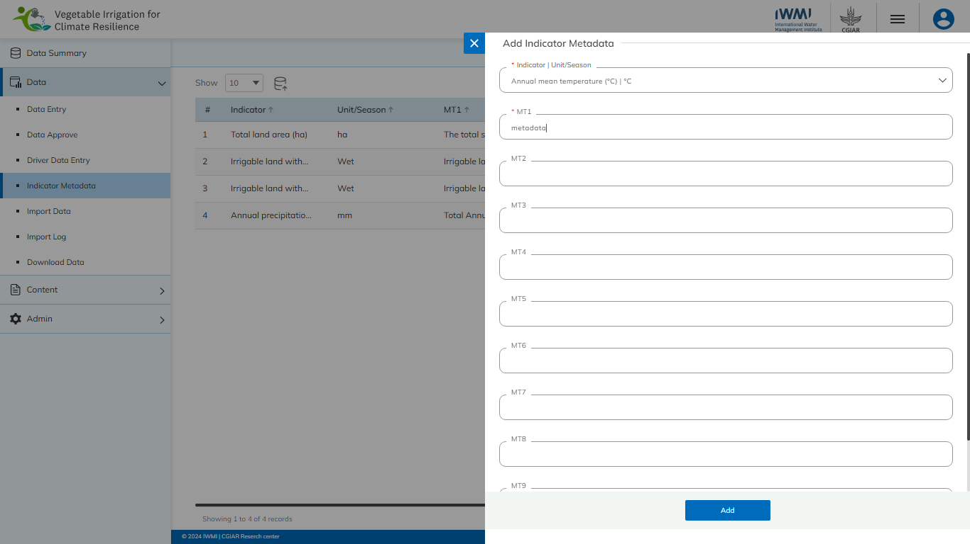
INDICATOR METADATA
Enter the mandatory details and click on Add button to confirm.

Slide 31
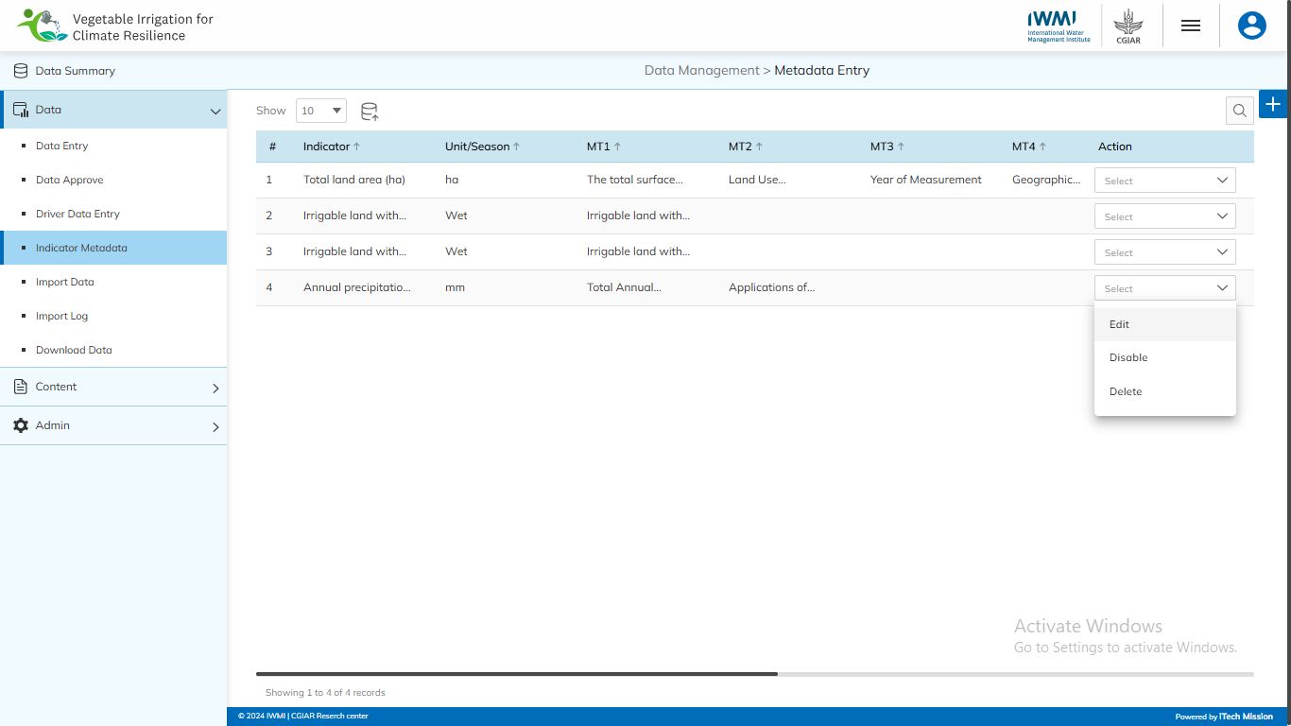
INDICATOR METADATA
Edit, enable/disable, and delete the selected metadata.

Slide 32
INDICATOR METADATA
Click on the Import button to import metadata.

Slide 33
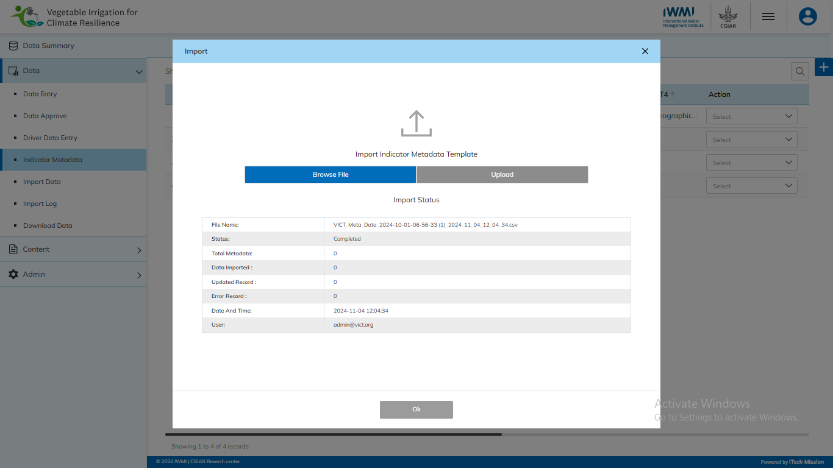
INDICATOR METADATA
Browse the file and click the Upload button to start the import process. Click on the OK button to confirm.

Slide 34
INDICATOR METADATA
View the Last Import Summary once the import process is completed.

Slide 35
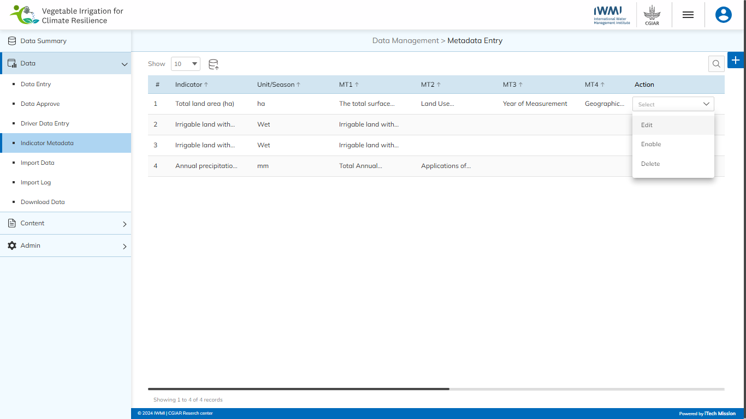
INDICATOR METADATA
Edit, enable/disable, and delete the Indicator metadata.

Slide 36
2
Data –
Import Data

Slide 37
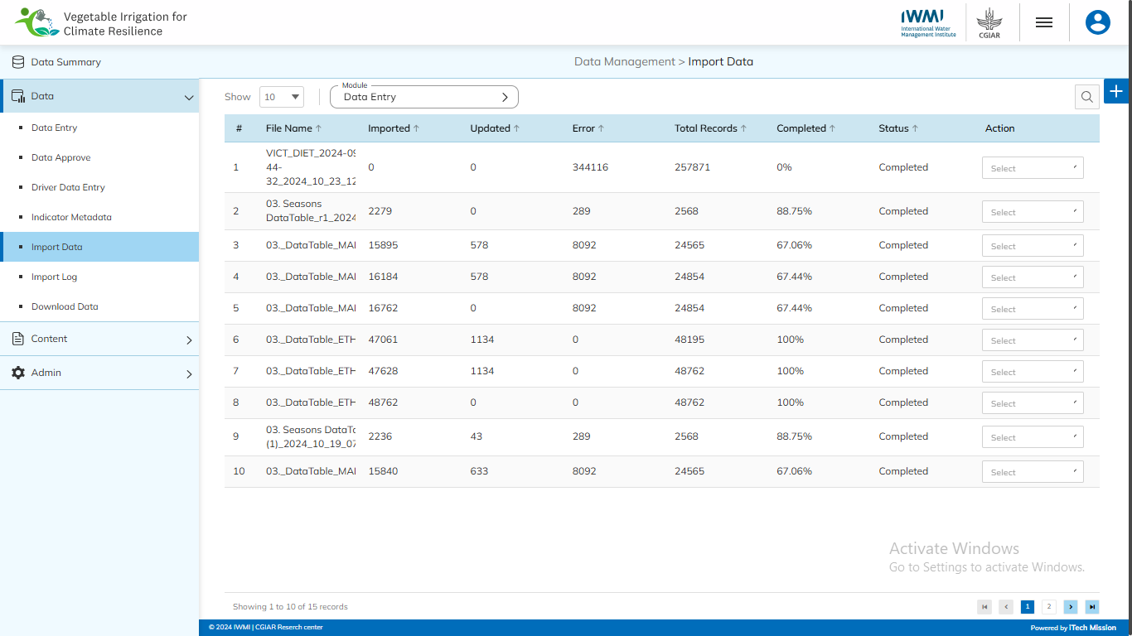
IMPORT DATA
Navigate to the “Import Data” sub-module available under the “Data” module.

Slide 38
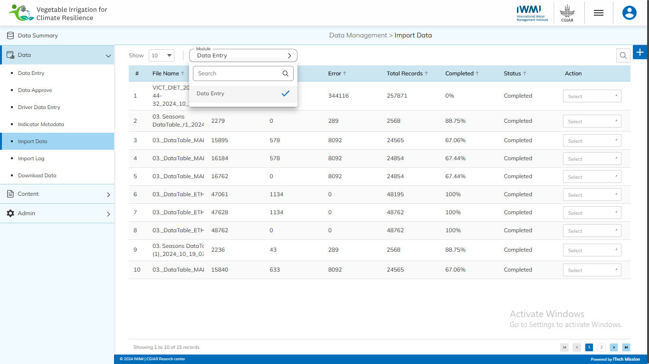
IMPORT DATA
Select the Module and click on plus button to import the respective data.

Slide 39
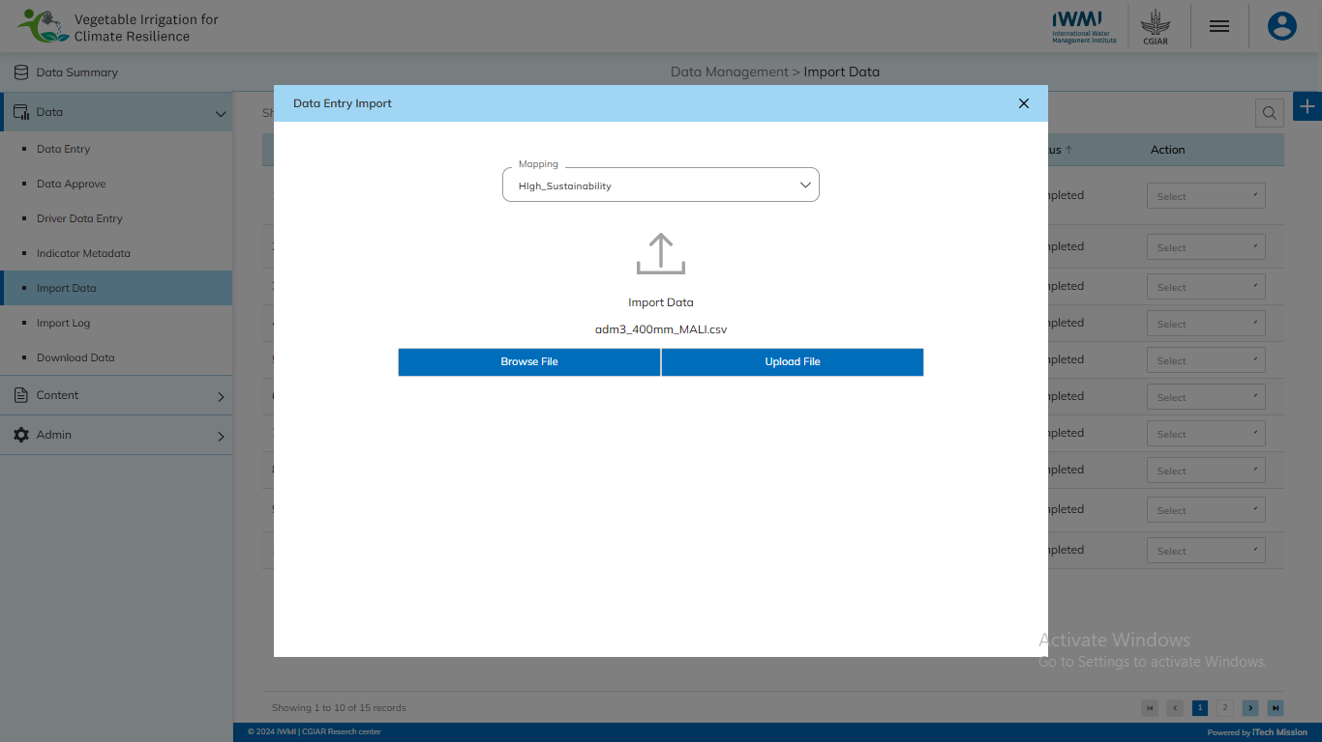
IMPORT DATA
Select the respective Mapping, Browse the file and click the Upload button to import the data.

Slide 40

IMPORT DATA
Download Log and Delete the selected Import.

Slide 41
2
Data –
Import Log

Slide 42
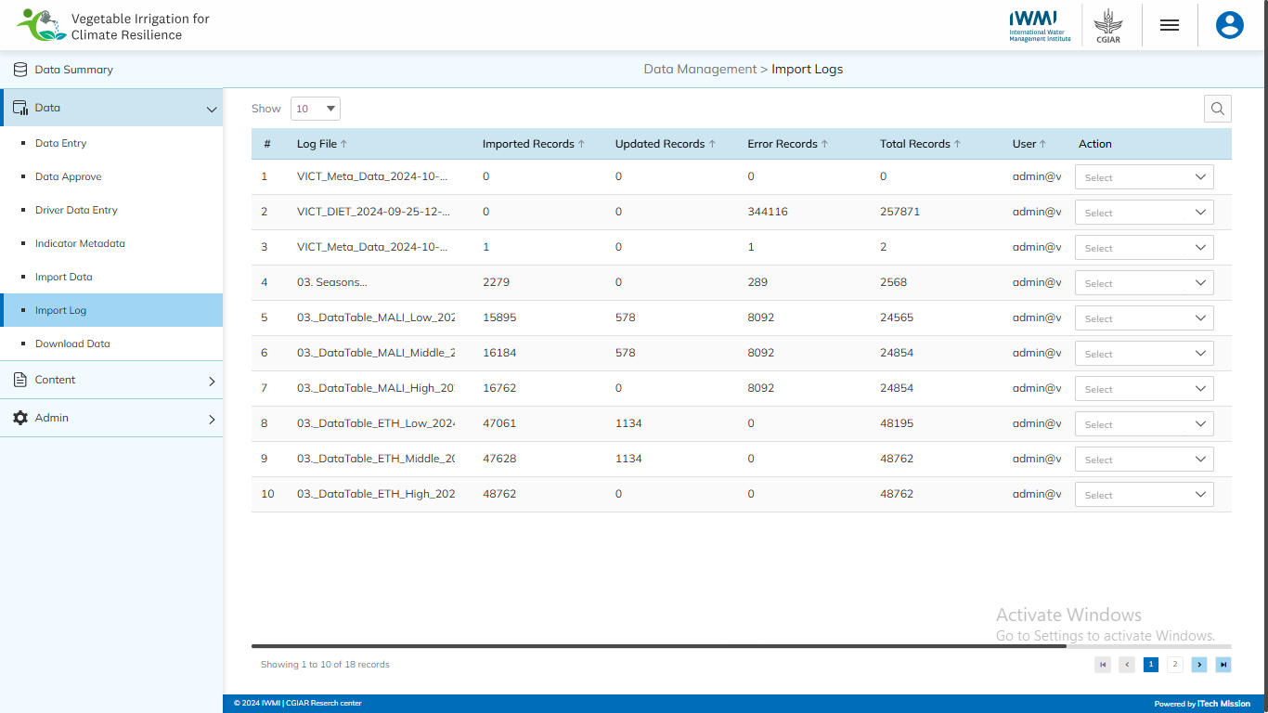
IMPORT LOG
Navigate to the “Import Log” sub-module available under the “Data” module.

Slide 43
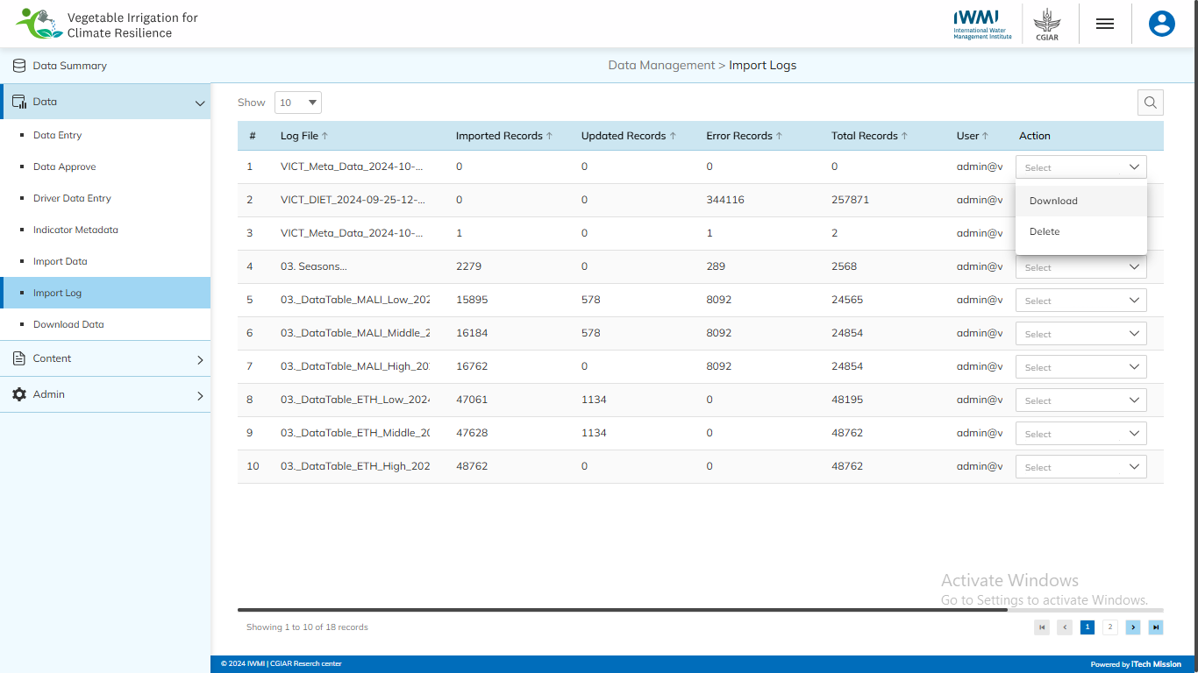
IMPORT LOG
Download Log and Delete the selected data.

Slide 44
2
Data –
Download Data

Slide 45
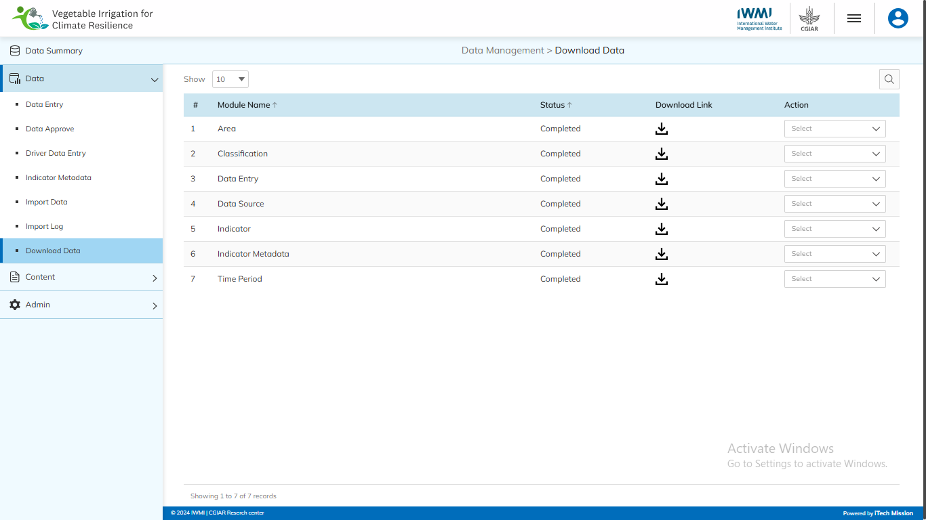
DOWNLOAD DATA
Navigate to the “Download Data” sub-module available under the “Data” module.

Slide 46
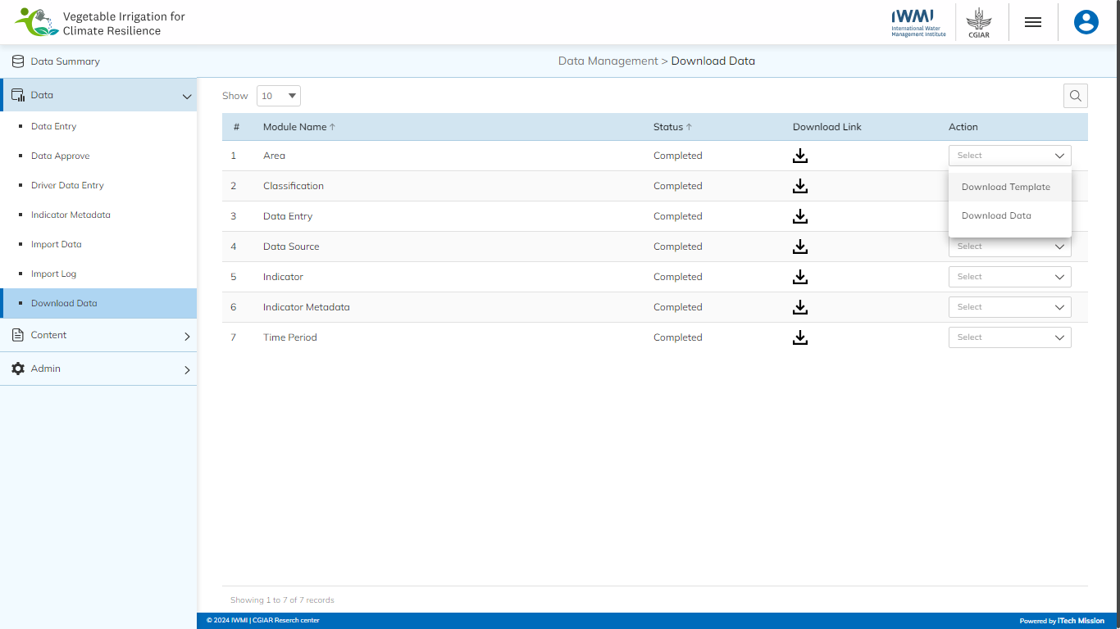
DOWNLOAD DATA
Click on the Download Template option to download the empty template of the selected module.

Slide 47
DOWNLOAD DATA
Click on the Download Data option to generate the download link of the selected module.

Slide 48
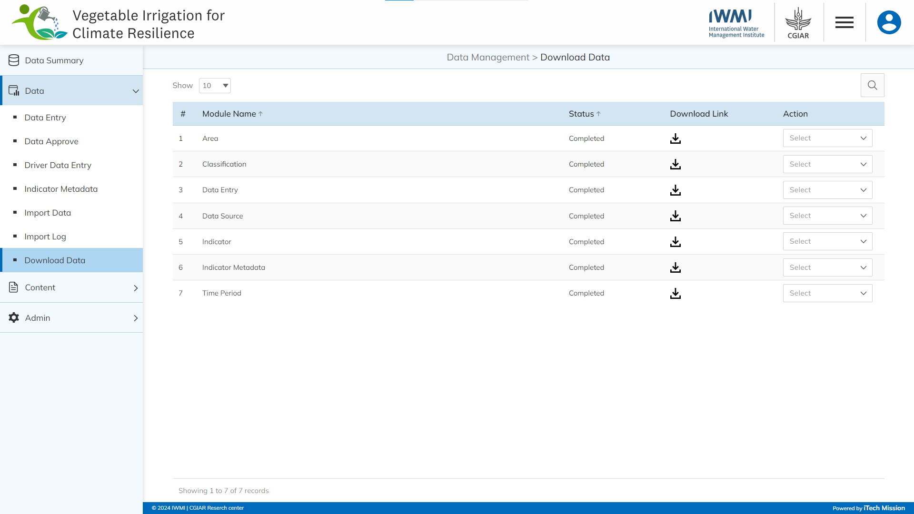
DOWNLOAD DATA
Click on the Download button to download the data of the selected module.

Slide 49
3
Content –
Category- Subcategory

Slide 50
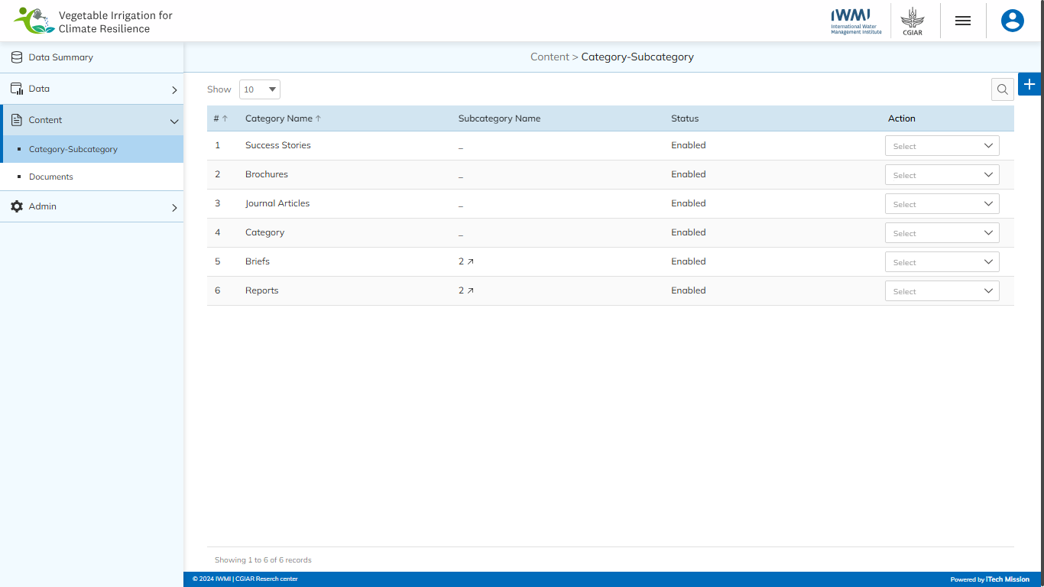
CATEGORY - SUBCATEGORY
Navigate to the “Category-Subcategory” sub-module available under the “Content” module.

Slide 51

CATEGORY - SUBCATEGORY
Click on the Plus button to add a new Category-Subcategory.

Slide 52
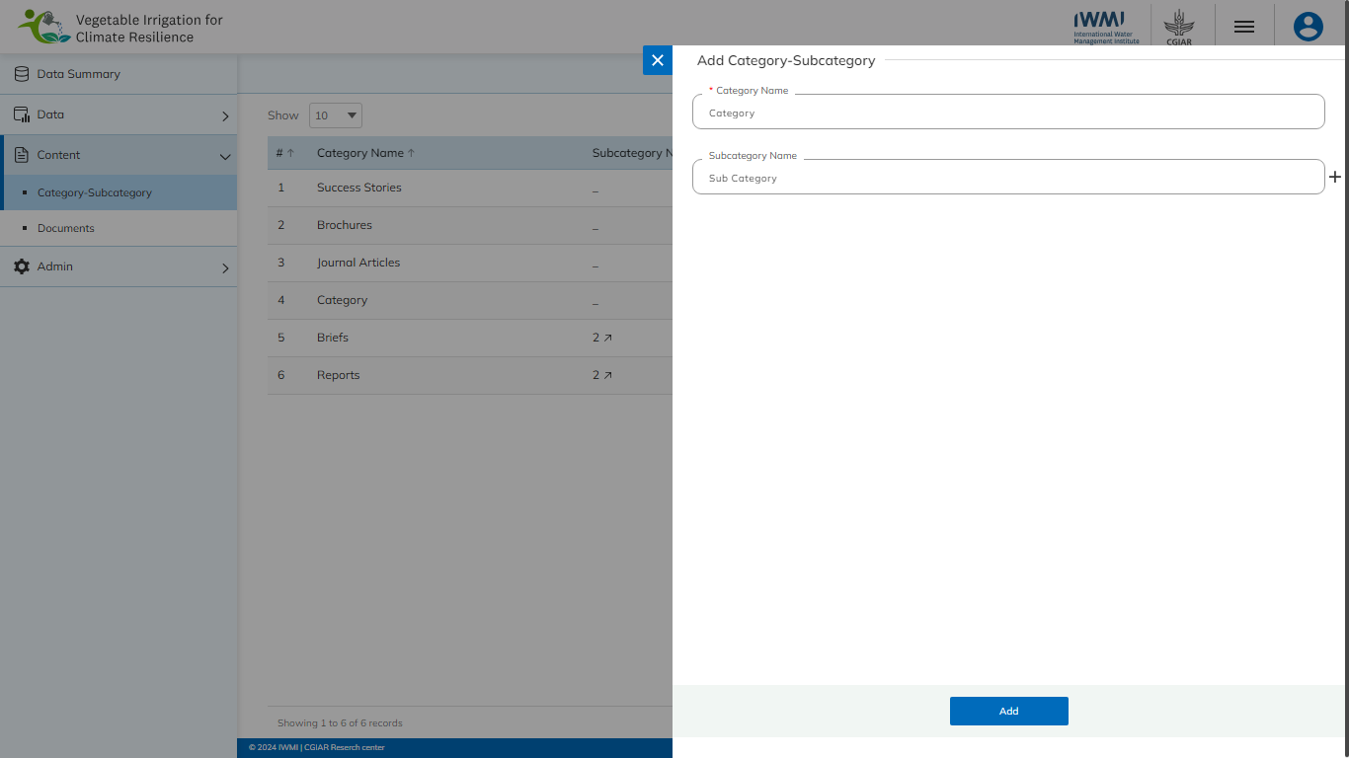
CATEGORY - SUBCATEGORY
Enter the mandatory details and click on Add button to confirm.

Slide 53

CATEGORY - SUBCATEGORY
Edit, delete, and enable/disable the Category-Subcategory.

Slide 54
3
Content –
Documents

Slide 55
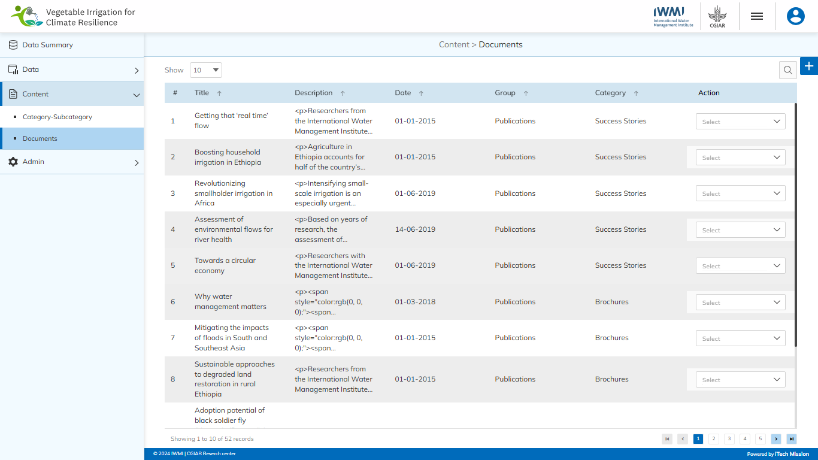
DOCUMENT
Navigate to the “Document” sub-module available under the “Content” module.

Slide 56
DOCUMENT
Click on the Plus button to add a new Document.

Slide 57
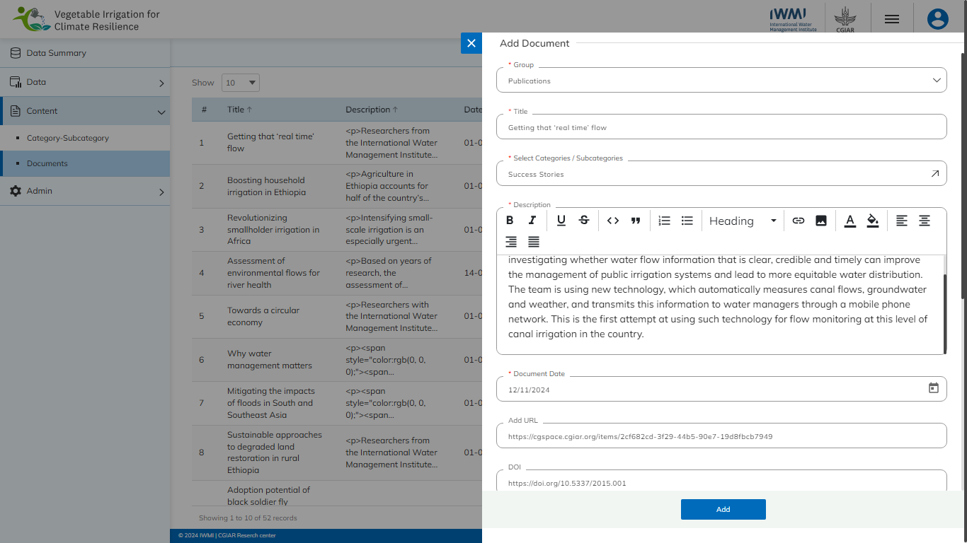
DOCUMENT
Enter the mandatory details to add data and click on Add button to confirm.

Slide 58
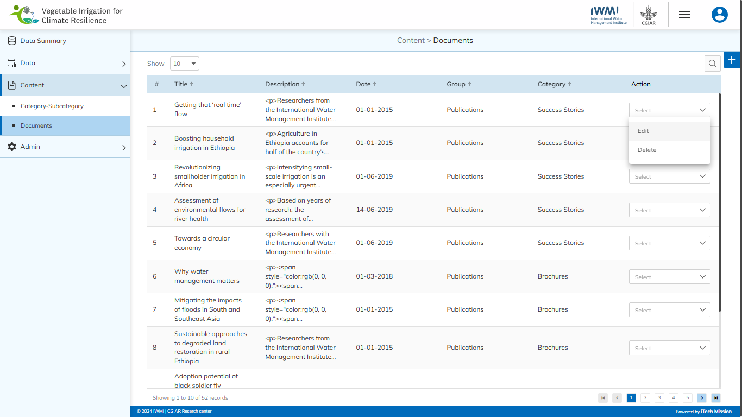
DOCUMENT
Edit and delete the Document.

Slide 59
4
Admin –
Area

Slide 60
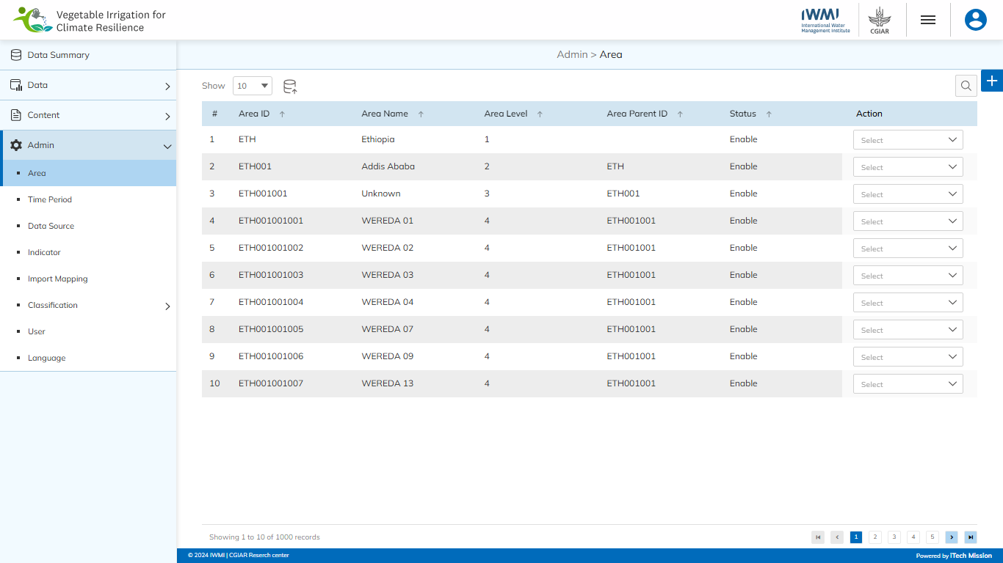
AREA
Navigate to the “Area” sub-module available under the “Admin” module.

Slide 61

AREA
Click on the Plus button to add a new Area.

Slide 62
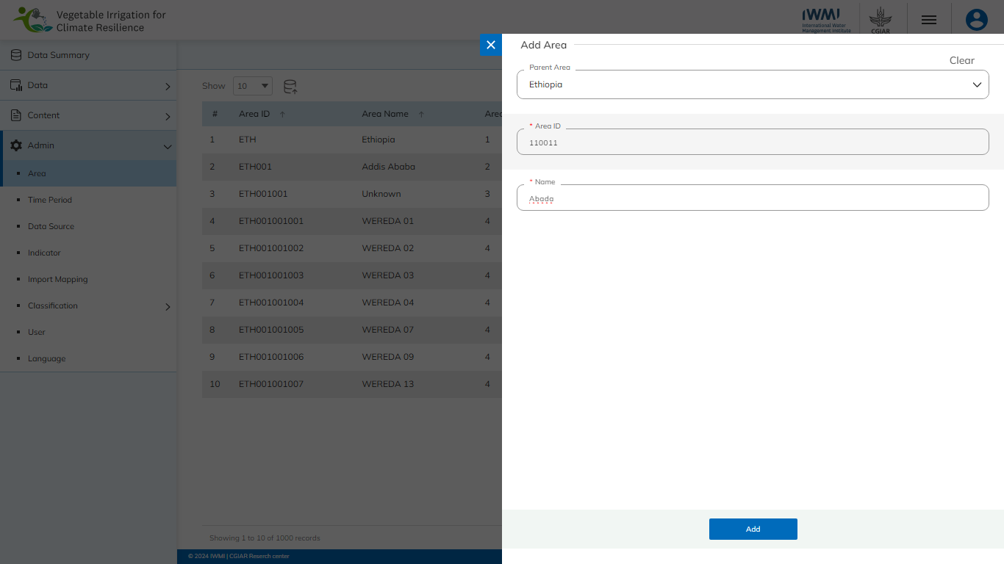
AREA
Enter the mandatory details and click on Add button to confirm.

Slide 63

AREA
Click on the Import button to import Area data.

Slide 64
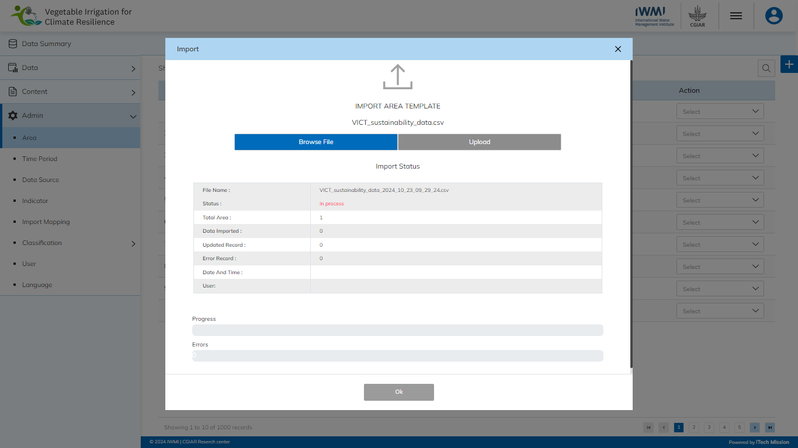
AREA
Browse the file and click the Upload button to start the import process. Click on the OK button to confirm.

Slide 65
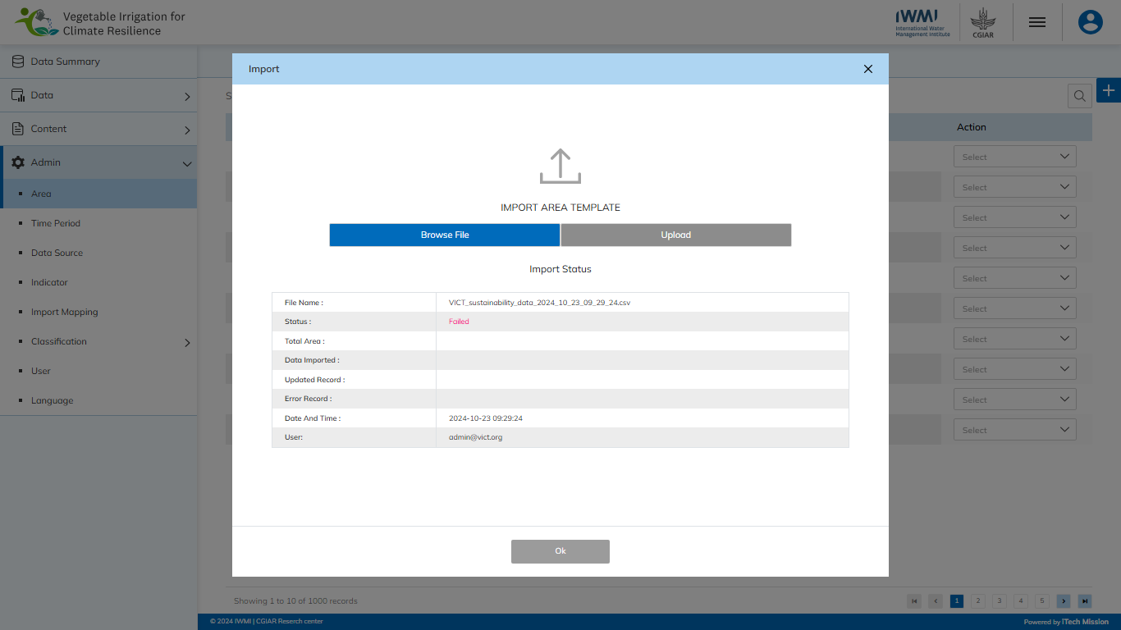
AREA
View the Last Import Summary once the import process is completed.

Slide 66
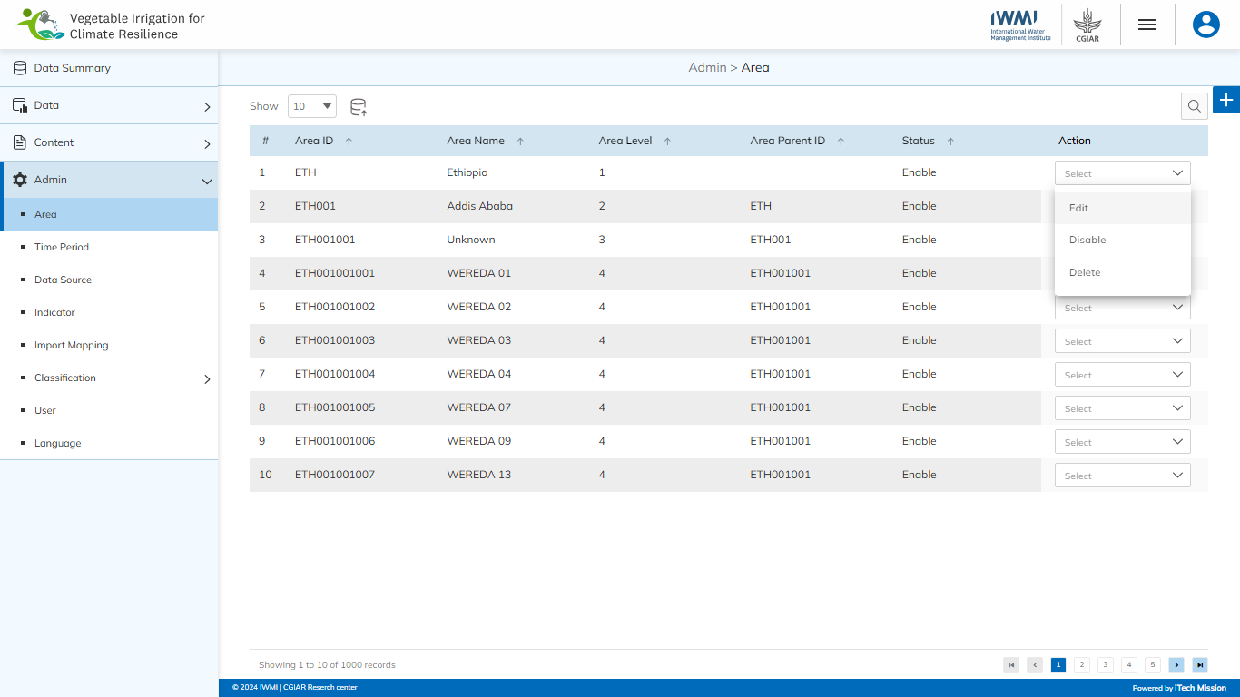
AREA
Edit, delete, and enable/disable the Area.

Slide 67
4
Admin –
Time Period

Slide 68
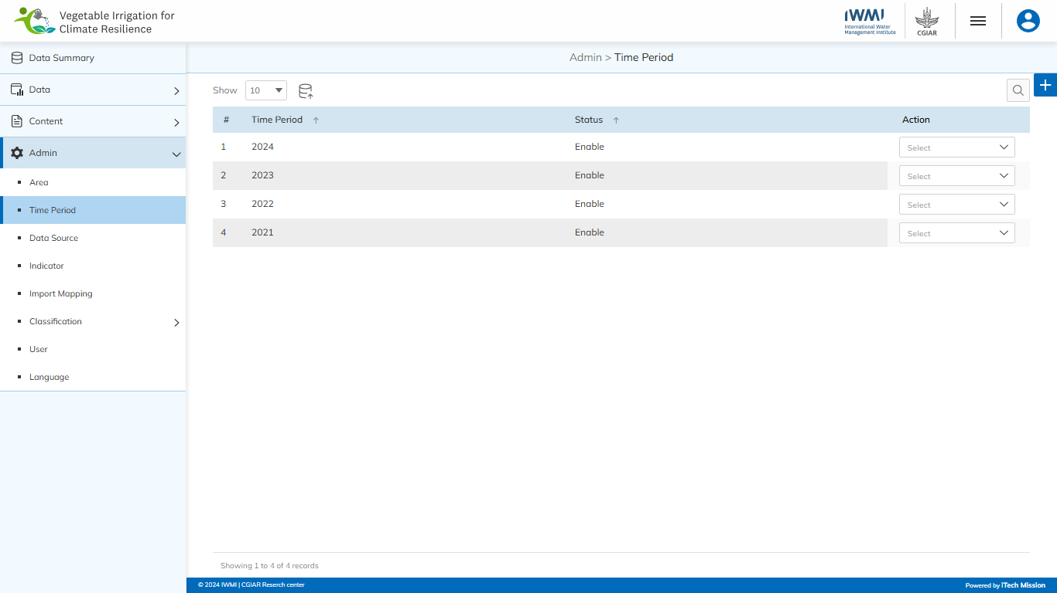
TIME PERIOD
Navigate to the “Time Period” sub-module available under the “Admin” module.

Slide 69

TIME PERIOD
Click on the Plus button to add a new Time Period.

Slide 70
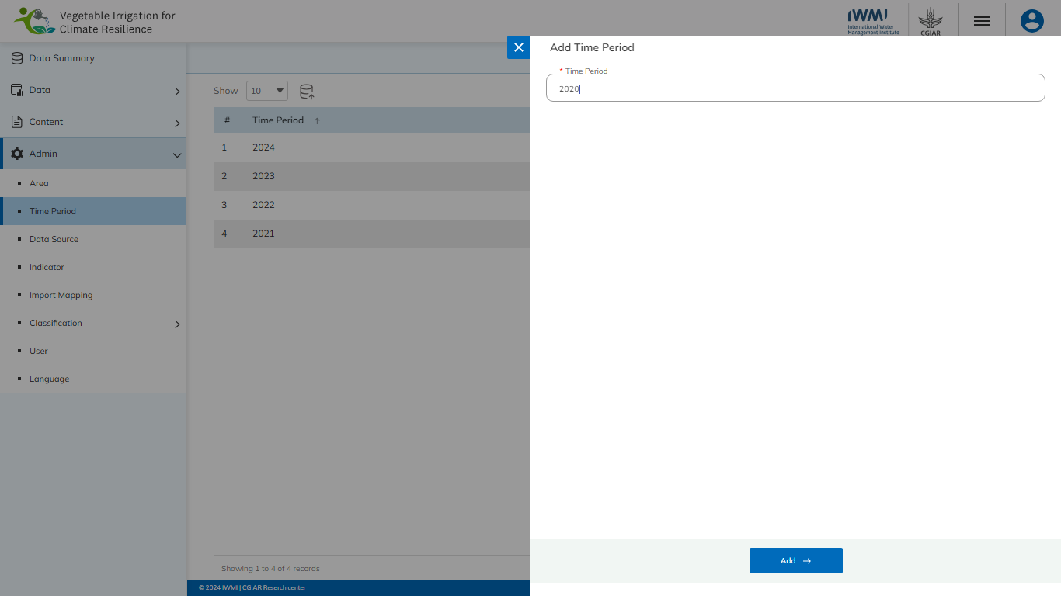
TIME PERIOD
Enter the mandatory details and click on Add button to confirm.

Slide 71

TIME PERIOD
Click on the Import button to import Time Period.

Slide 72
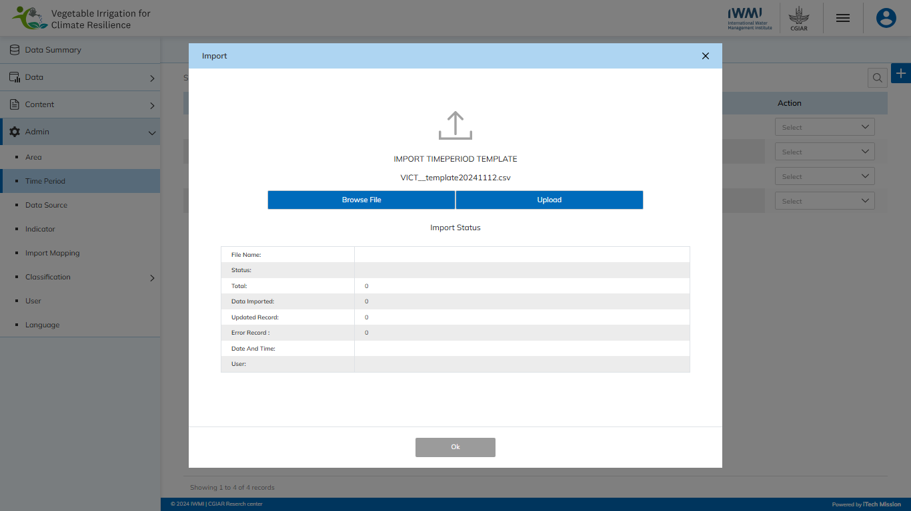
TIME PERIOD
Browse the file and click the Upload button to start the import process. Click on the OK button to confirm.

Slide 73
TIME PERIOD
View the Last Import Summary once the import process is completed.

Slide 74

TIME PERIOD
Edit, delete, and enable/disable the Time Period.

Slide 75
4
Admin –
Data Source

Slide 76
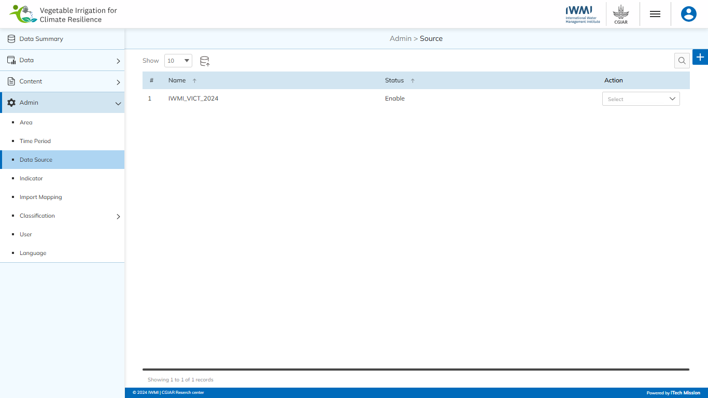
DATA SOURCE
Navigate to the “Data Source” sub-module available under the “Admin” module.

Slide 77

DATA SOURCE
Click on plus button to add a new Data Source.

Slide 78
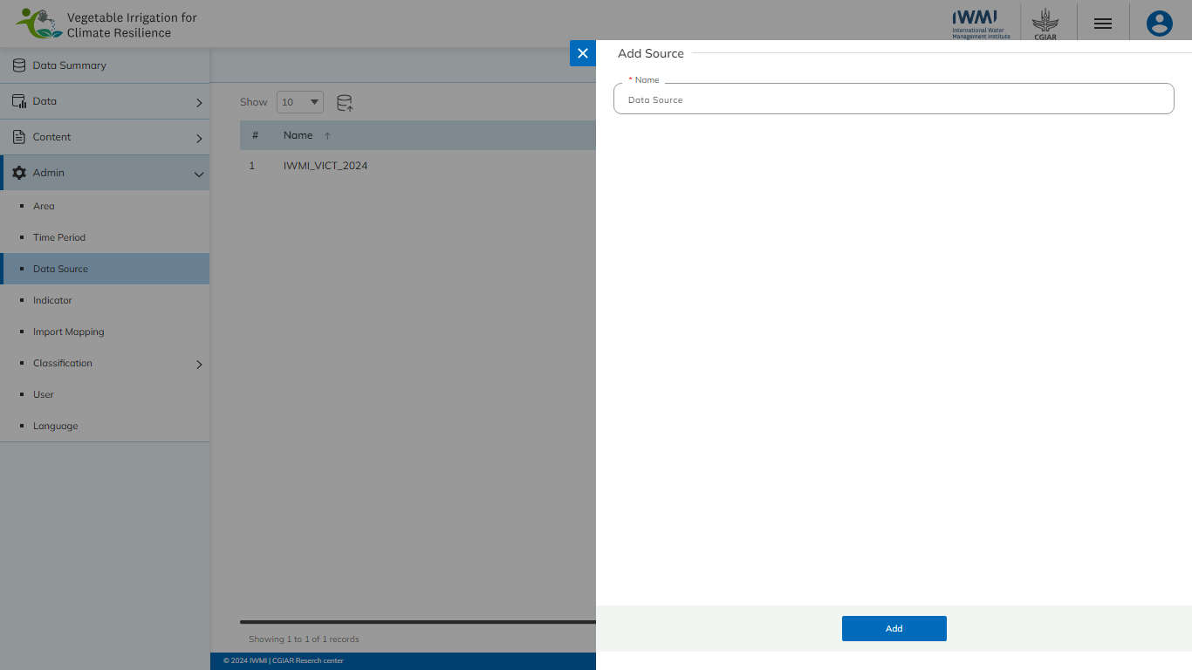
DATA SOURCE
Enter the mandatory details and click on Add button to confirm.

Slide 79

DATA SOURCE
Click on the Import button to import Data Source.

Slide 80
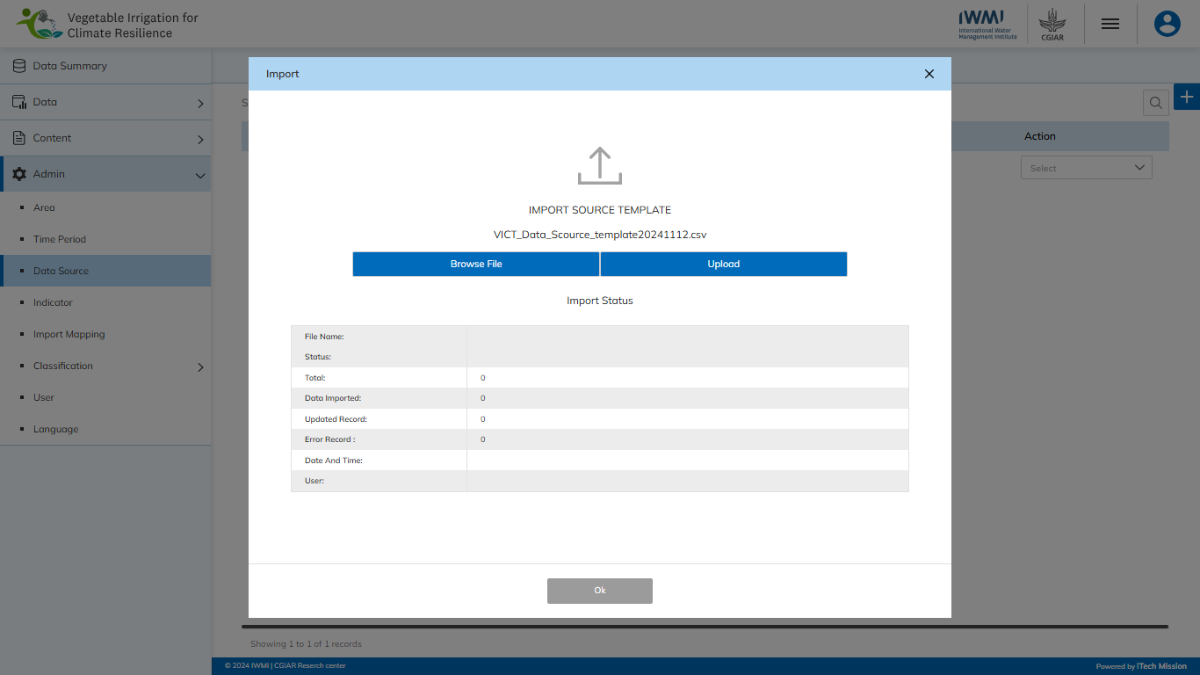
DATA SOURCE
Browse the file and click the Upload button to start the import process. Click on the OK button to confirm.

Slide 81
DATA SOURCE
View the Last Import Summary once the import process is completed.

Slide 82

DATA SOURCE
Edit, delete, and enable/disable the Data Source.

Slide 83
4
Admin –
Indicator

Slide 84
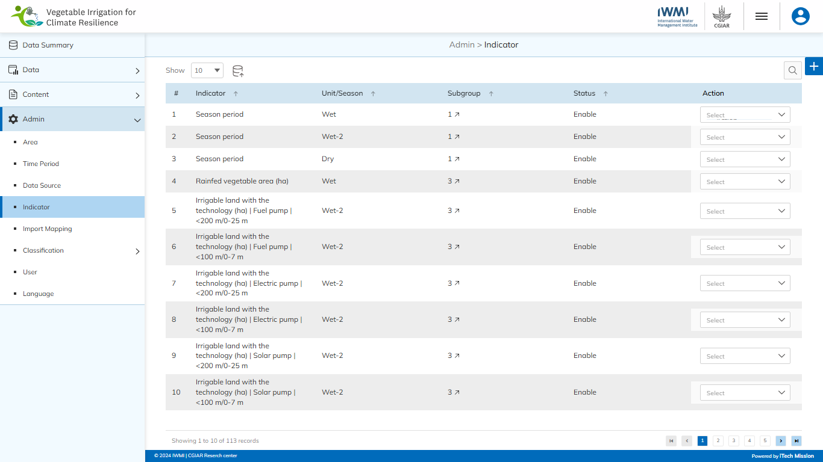
INDICATOR
Navigate to the “Indicator” sub-module available under the “Admin” module.

Slide 85
INDICATOR
Click on plus button to add a new Indicator.

Slide 86
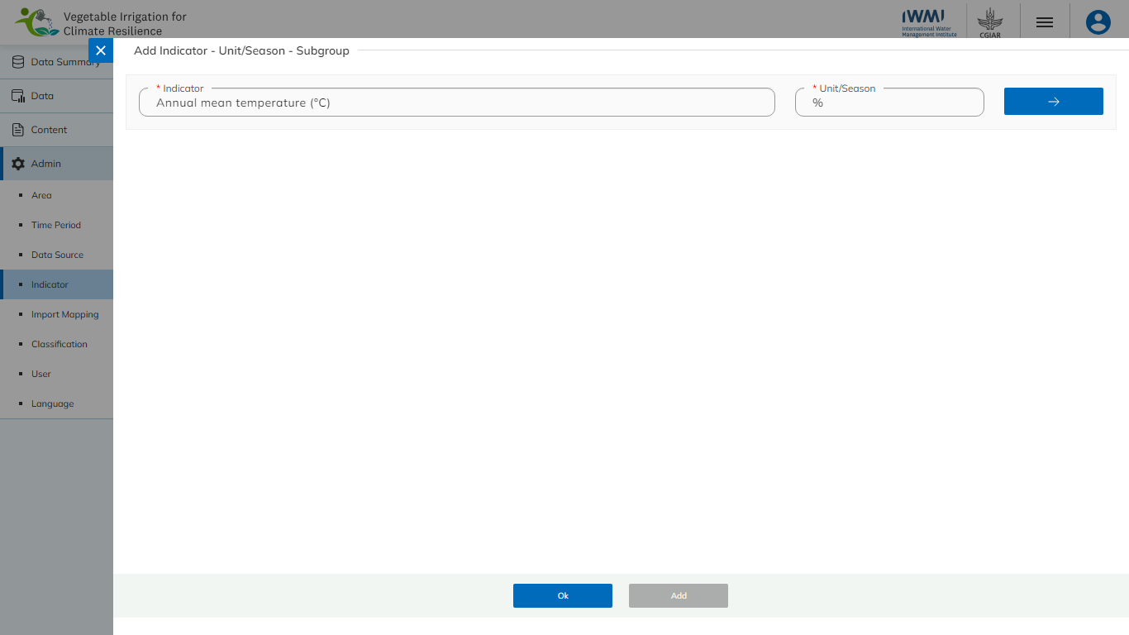
INDICATOR
Enter the mandatory details to add data and click on Arrow button to continue.

Slide 87
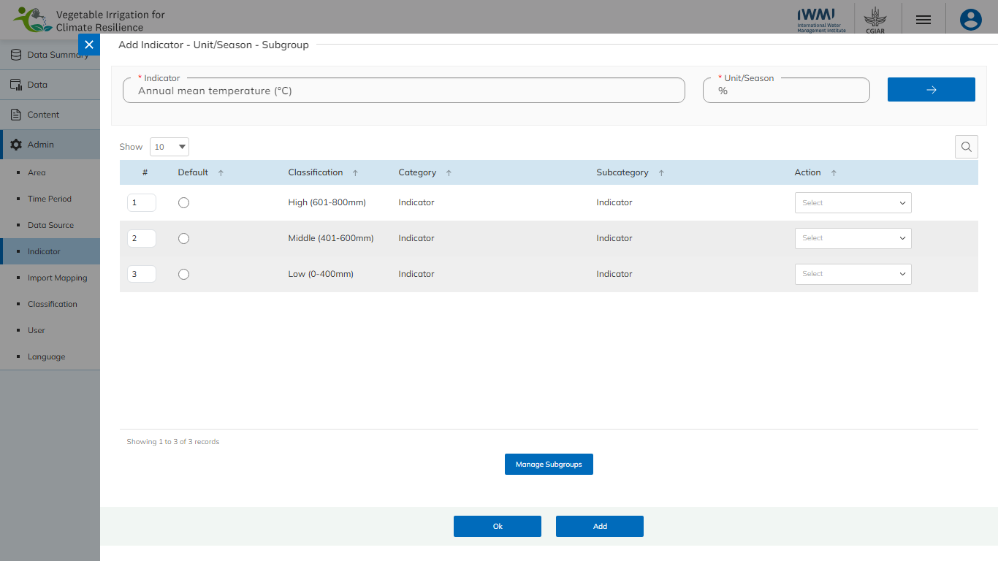
INDICATOR
Click on the Manage Subgroups button to add Subgroups.

Slide 88

INDICATOR
Select the Classification and Topic and click on Add button to confirm.

Slide 89
INDICATOR
Click on Add button to confirm.

Slide 90

INDICATOR
Click on the Import button to import Indicator data.

Slide 91

INDICATOR
Browse the file and click the Upload button to start the import process. Click on the OK button to confirm.

Slide 92

INDICATOR
Edit the Indicator Data.

Slide 93
4
Admin –
Import Mapping

Slide 94

IMPORT MAPPING
Navigate to the “Import Mapping” sub-module available under the “Admin” module.

Slide 95
IMPORT MAPPING
Click on plus button to add a new Mapping.

Slide 96

IMPORT MAPPING
Enter the mandatory details to add data and click on Add button to confirm.

Slide 97

IMPORT MAPPING
Edit and delete the Mappings.

Slide 98
Admin –
Classification –
Classification Type
4

Slide 99

CLASSIFICATION TYPE
Navigate to the “Classification Type” from the “Classification” sub-module available under the “Admin” module.

Slide 100
CLASSIFICATION TYPE
Click on plus button to add a new Classification Type.

Slide 101

CLASSIFICATION TYPE
Enter the mandatory details to add data and click on Add button to confirm.

Slide 102

CLASSIFICATION TYPE
Edit, delete, and enable/disable the Classification Type.

Slide 103
Admin –
Classification –
Classification
4

Slide 104

CLASSIFICATION
Navigate to the “Classification” from the “Classification” sub-module available under the “Admin” module.

Slide 105

CLASSIFICATION
Select the Classification Type and click on plus button to add a new Classification.

Slide 106

CLASSIFICATION
Enter the mandatory details to add data and click on Add button to confirm.

Slide 107
CLASSIFICATION
Click on the Import button to import Classification.

Slide 108

CLASSIFICATION
Browse the file and click the upload button to start the import process. Click on the OK button to confirm.

Slide 109
CLASSIFICATION
View the Last Import Summary once the import process is completed.

Slide 110

CLASSIFICATION
Edit, delete, and enable/disable the Classification.

Slide 111
4
Admin –
User

Slide 112

USER
Navigate to the “User” sub-module available under the “Admin” module.

Slide 113
USER
Click on plus button to add a new User.

Slide 114

USER
Enter the mandatory details to add data and click on Add button to confirm.

Slide 115

USER
Edit, delete, and enable/disable the User data.

Slide 116
4
Admin –
Language

Slide 117

LANGUAGE
Navigate to the “Language” sub-module available under the “Admin” module.

Slide 118

LANGUAGE
Select the “Module” to view the Language Translations.

Slide 119

LANGUAGE
Click on the Export button to download Language Translations.

Slide 120

LANGUAGE
Click on Empty to download the Empty Template or click on With Data to download Pre-existing Language Translations.

Slide 121

LANGUAGE
Click on the Import button to import Language Translations.

Slide 122

LANGUAGE
Browse the file and click the Upload button to start the import process. Click on the OK button to confirm.

Slide 123

LANGUAGE
View the Last Import Summary once the import process is completed.

Slide 124

LANGUAGE
Click on the Save icon to update the Language translations.

Slide 125


